Slide 1
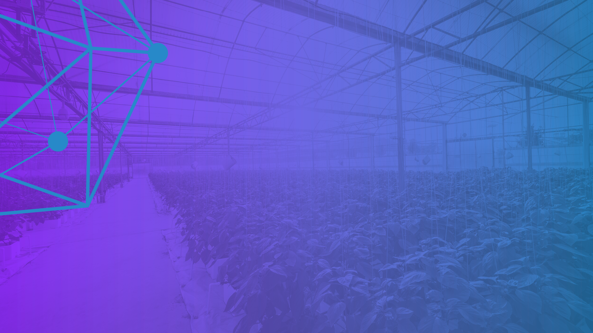

China’s Expansion of
Open Source Blockchain
Open Source Summit June 25, 2019
Brian Behlendorf,
Executive Director, Hyperledger
The Linux Foundation

Slide 2
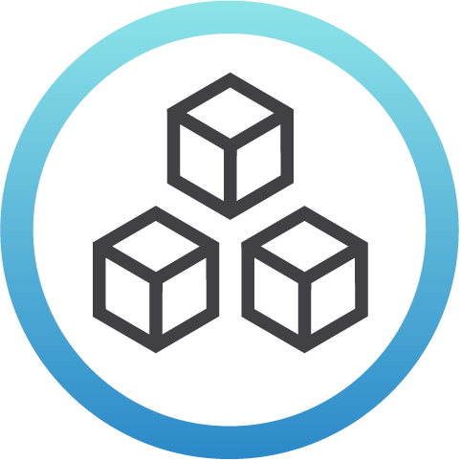


What Is Hyperledger?
Open source collaborative effort to advance cross- industry blockchain technologies
Hosted by
The Linux Foundation
Global collaboration spanning developers and employers in finance, technology, supply chain, healthcare and more
Notes:
Hyperledger is an open source collaborative effort created to advance cross-industry blockchain technologies. Hyperledger is the fastest growing project ever hosted by The Linux Foundation. Hyperledger now has more than 270 members. The project was first announced with 30 members in February of 2016. Hyperledger members exist in 25 different countries with 39% in APAC (25% in China), 20% in EMEA and 41% spread across North America. Our membership also spans multiple industries, including finance, banking, internet of things, supply chain, manufacturing, healthcare, and technology.

Slide 3

Hyperledger has a modular approach to hosting software projects. Think of Hyperledger as a greenhouse for developing business blockchain projects from initial experiment in Labs (seed) to stable code ready for production (fruition).
Notes:
The Linux Foundation and Hyperledger provide the infrastructure for open development to occur among a diverse and thriving community.
Under Hyperledger’s umbrella are frameworks and tools that take different approaches to creating blockchains for business.
There are many benefits to this modular approach.

Slide 4
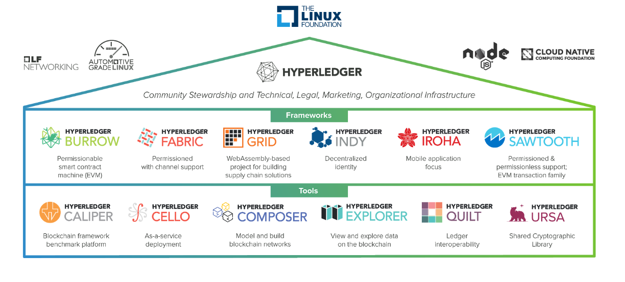

Slide 5
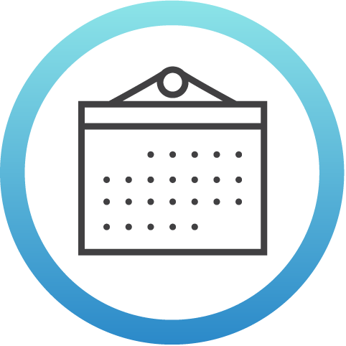

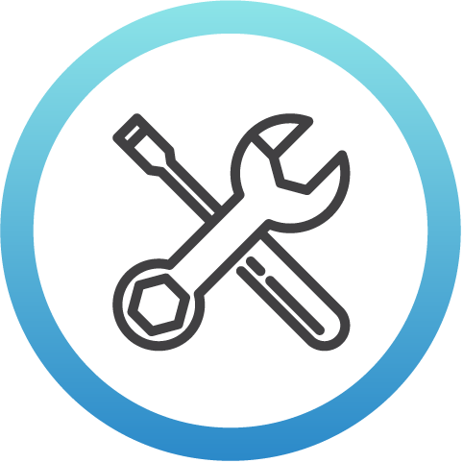
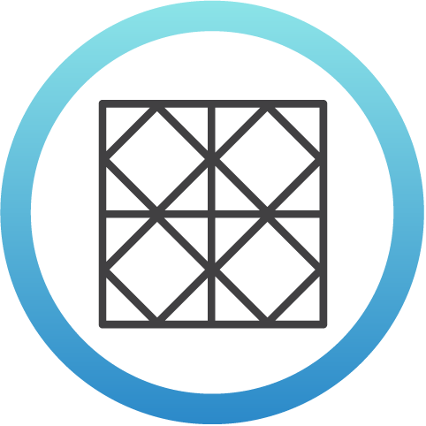




Hyperledger Momentum
3
Years since launch
126K+
Commits
6
Tools
6
Frameworks
4
1.0+ Production Releases
275+
Members (50+ in China)
10
Active Community Working Groups &
Special Interest Groups
160+
Meetups Worldwide
(66 countries)
44K+
Meetup Participants
2,000+
Media Clips Per Month

Slide 6
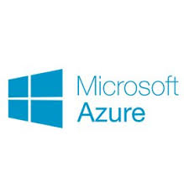


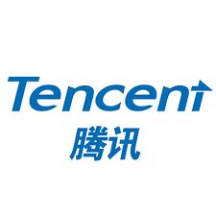




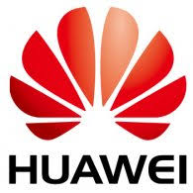


Hyperledger Fabric: Now On All Major Clouds

Slide 7
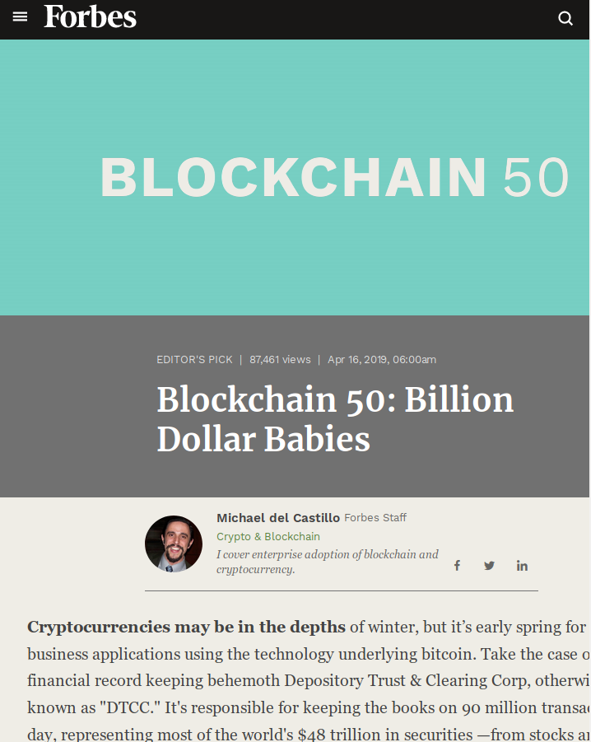
So who’s using what?
Of the Forbes Blockchain 50:
23 HL Fabric
+5 IBM Blockchain
+2 DTCC & Google
+1 Oracle Blockchain
+1 Samsung Nexledger
21 (Public?) Ethereum
13 Corda
12 Quorum
3 HL Indy
3 HL Sawtooth

Slide 8
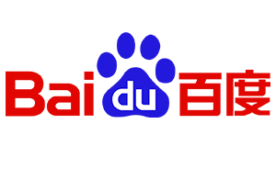
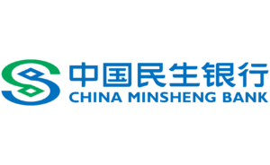


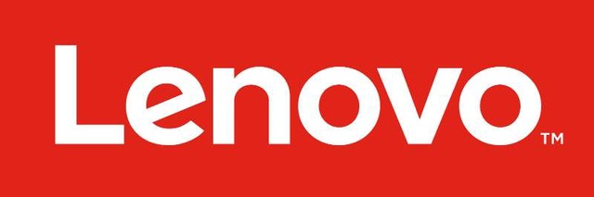
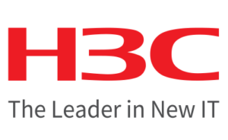



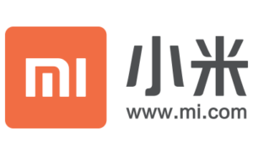



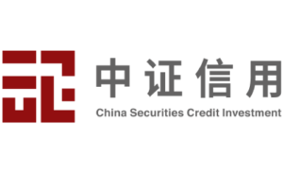
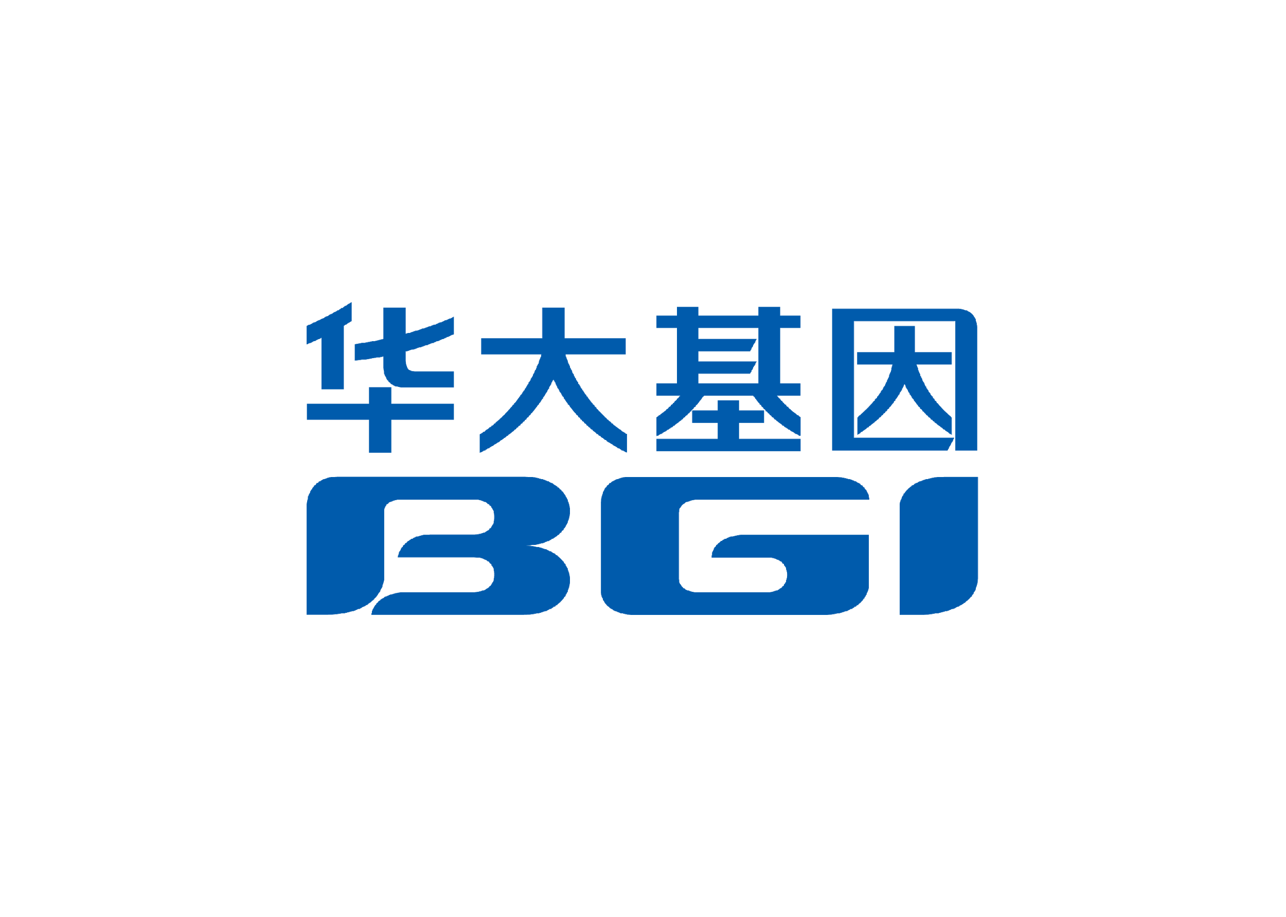
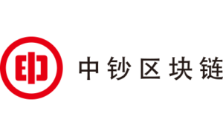
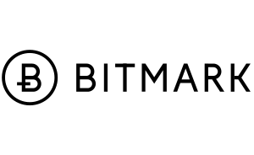
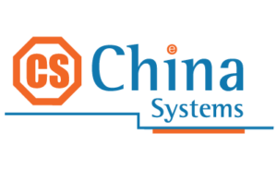
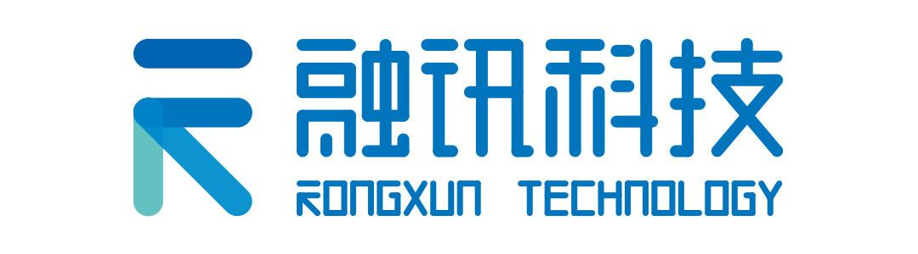
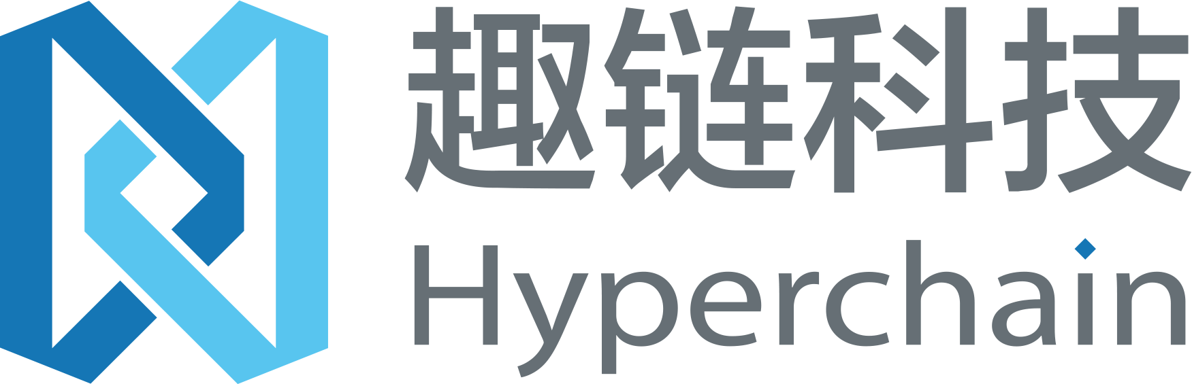
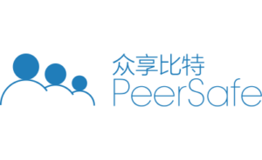
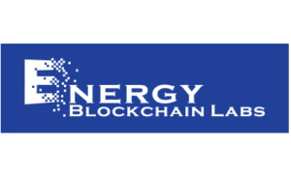


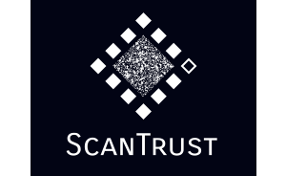
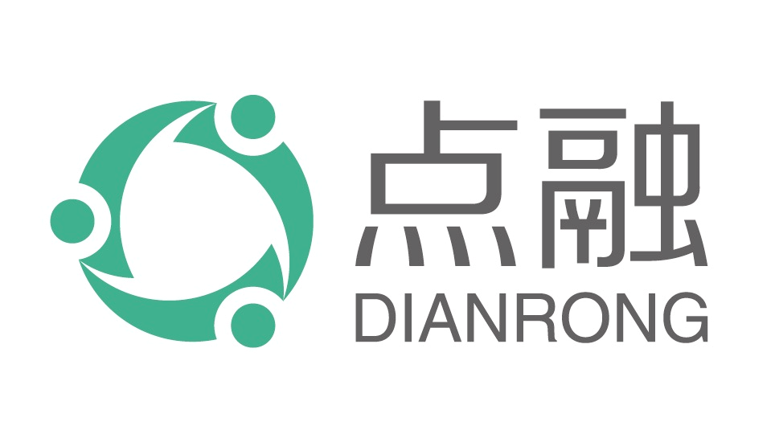
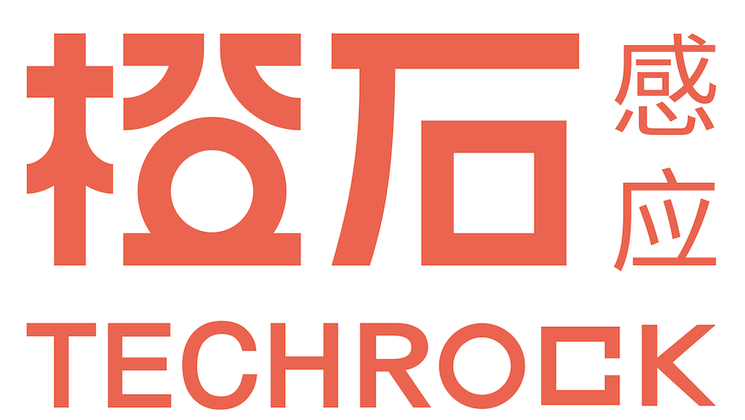

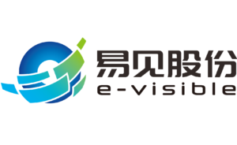
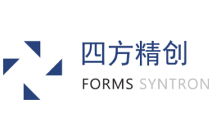
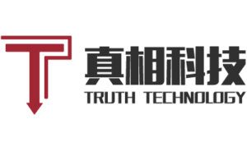
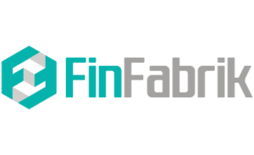
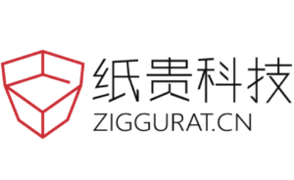

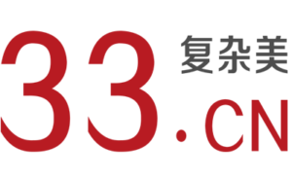
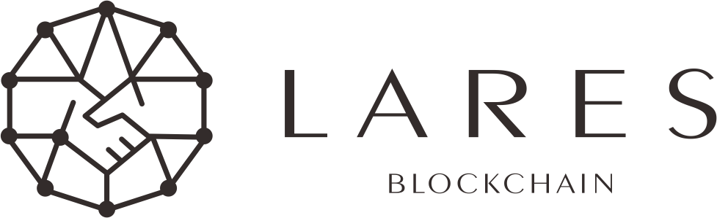

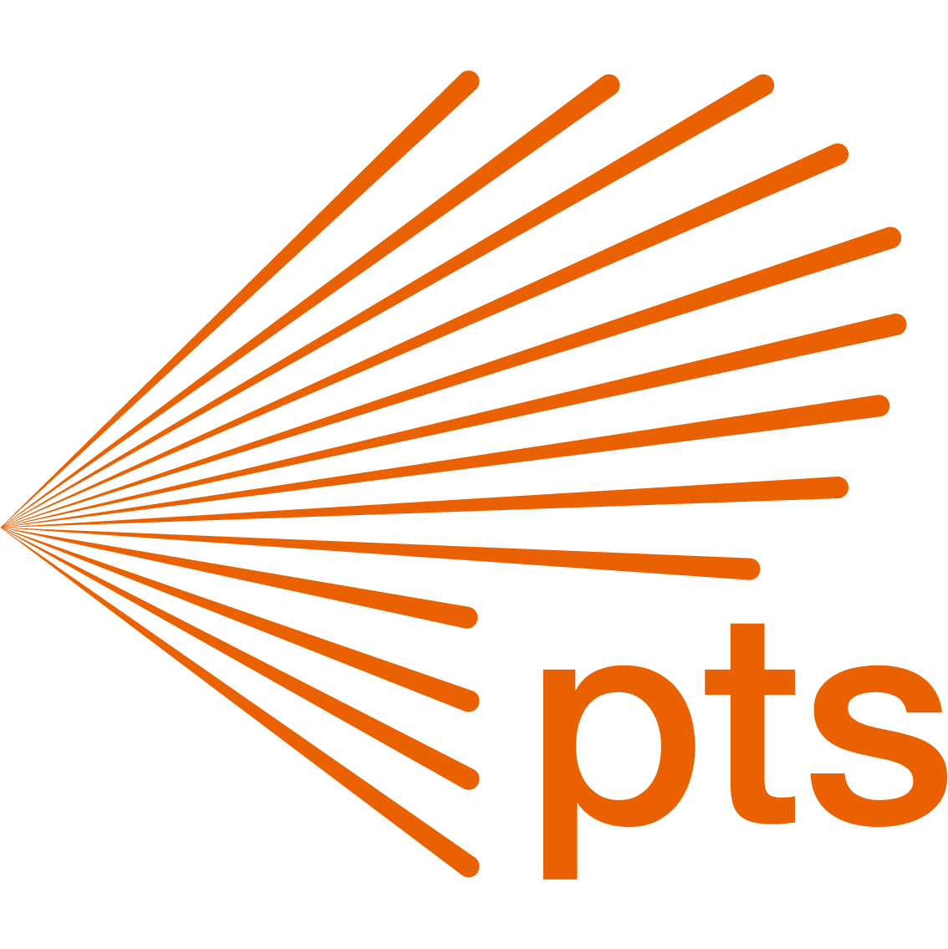






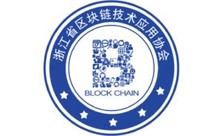



Hyperledger Members in China
高级会员:
标准会员:
联盟会员：
Notes:
北京：百度，中信，民生银行，Lenovo，小米，H3C，ANNE，Inspur，太一云，JD.com，瑞卓喜投，众享比特，真相科技，超链科技，远景视点，易见股份，纸贵科技，PDX，BIT.GAME,智链，BELINK，POINTS，北京大学
深圳：华为，招商银行，腾讯，迅雷，房掌柜，中证信用，融讯科技，华大基因，四方精创，新国都，
杭州：阿里云，Blockdao，趣链，中钞，复杂美，云象，Matrix，浙江区块链技术应用协会，浙江大学，
上海：Onechain，Chinasystem（南京），贝壳金控，Scantrust，金丘，能链科技，点融，BITMARK，
青岛：Inspur
成都：赤乌软件
香港：FinFabrik，MediConCen，Chinasystem
广州：小飞豹，中山大学
长沙：湖南大学

Slide 9
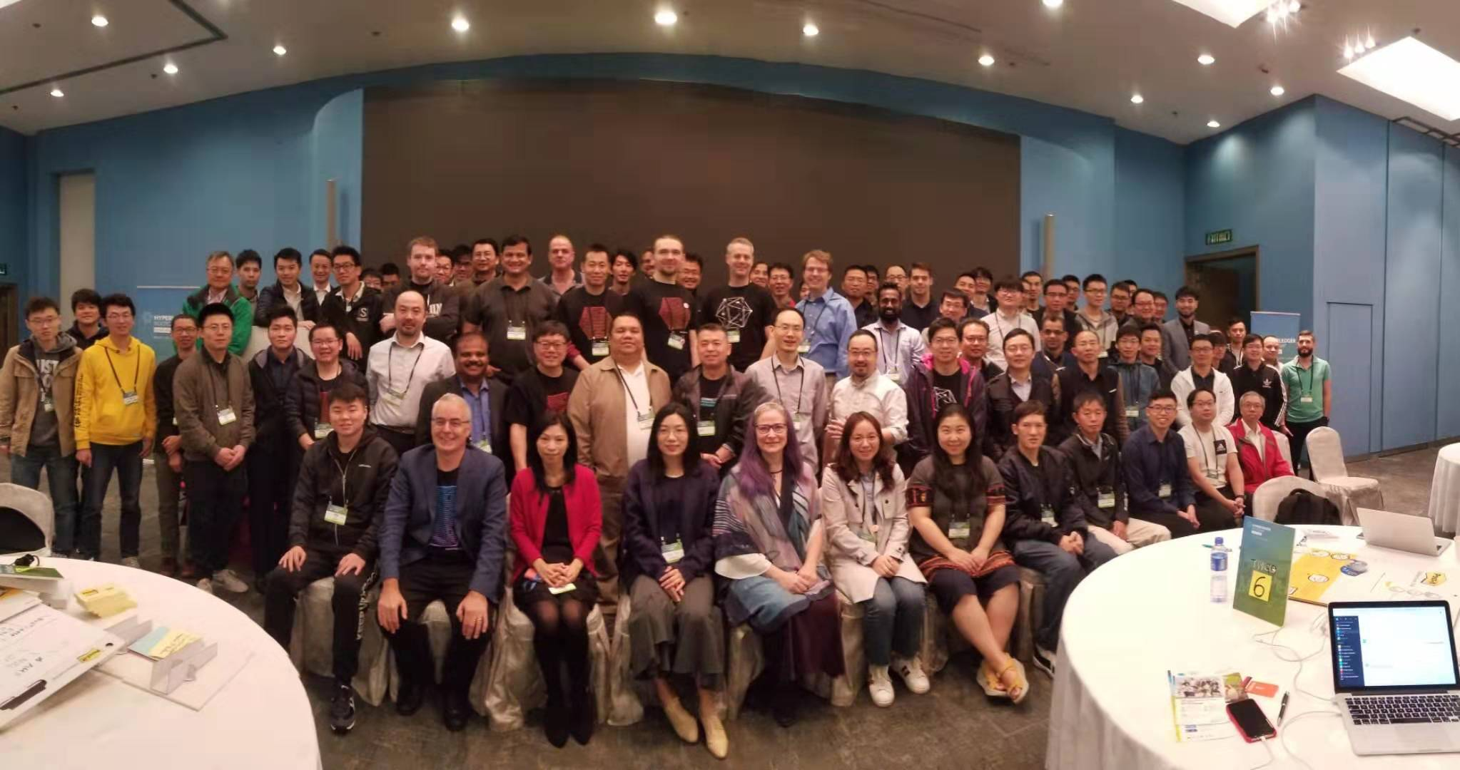
Hyperledger Hong Kong Bootcamp in March

Slide 10
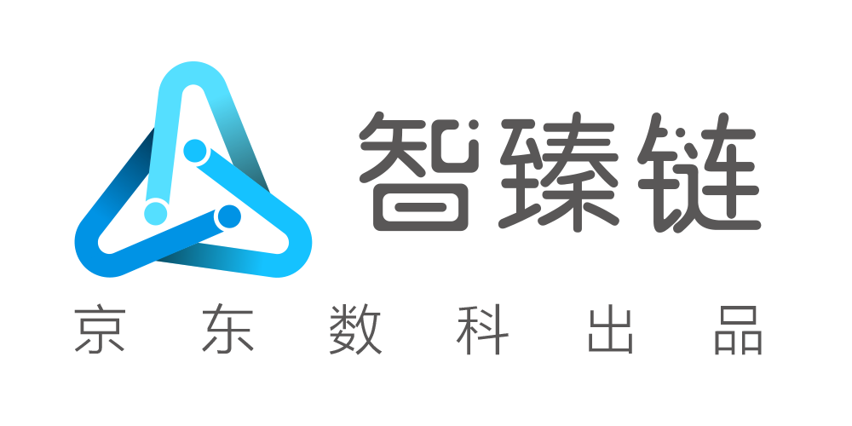


JD BaaS Platform For Multiple Blockchain Applications
The Challenge
Blockchain applications face a series of problems, including high technical threshold, security threat, unsatisfactory performance, high degree of difficulty to align blockchain technology with business needs, regulate identity, etc.
The Solution
The JD BaaS Platform won the 2019 Outstanding Blockchain Application Prize at the 2019 Global Blockchain Tech Innovation Summit during the 3rd World Intelligence Congress. The platform has already been used in fields including, finance, tax control, logistics, business licensing and law
Finance: Applying blockchain to asset-backed securitization (ABS) to enhance transparency, support immutable transaction records, improve capital management, speed up the deployment process, lower costs, and minimize credit risks
Product anti-counterfeiting: The JD BaaS Platform realizes visual traceability from point of origin to point of consumption, creating an innovative trustworthy consumption experience. As of February 2019, the JD Blockchain Anti-counterfeiting and Traceability Platform had stored more than 1.3 billion pieces of data, and traced over 700 brands and 50,000 SKUs on blockchain, queried by consumers 2.8 million times
Legal disputes: JD BaaS Platform helped the Guangzhou Internet Court to establish a judicial blockchain platform by providing technical support for construction of an intelligent credit ecosystem and accelerating the process of authenticating digital evidence in legal disputes
The Collaboration
JD BaaS Platform supports open-source blockchain frameworks like Hyperledger Fabric, providing comprehensive blockchain-based technical functionality. JD BaaS Platform has also realized the rapid deployment of consortium blockchain, which can help governments, enterprises, financial institutions and other organizations to eliminate technical barriers
.

Slide 11
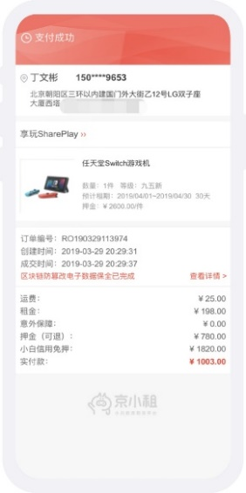
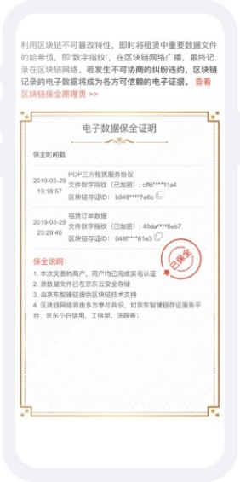
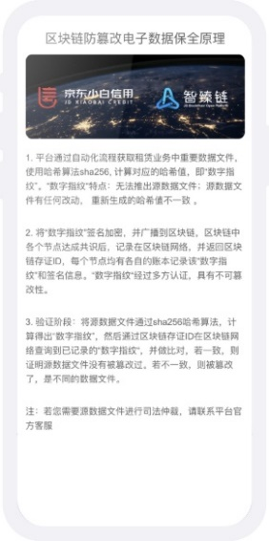
JD Eshare Blockchain Invoice and Contract Platform
The Challenge
In e-commerce, challenges include high technical thresholds to store credible data including digital contracts and online agreements, as well as the difficulty to authenticate digital evidence in order to safeguard legal rights when disputes happen
JD Eshare is the first credit leasing platform based on blockchain technology. It solves pain points in the rental market through putting deposit certificates on blockchain
Results
Eshare realizes the consensus, storage, and endorsement of data through consortium blockchain working with courts and other authoritative institutions to enhance creditability of the digital evidence, shorten the time to authenticate digital evidence, and improve the efficiency of solving rights protection disputes
The Solution
Eshare is based on Hyperledger Fabric structure, allowing customers to gather electronic evidence from Blockchain Invoice and Contract Platform and directly appeal to Guangzhou Internet Court. Guangzhou Internet Court compares can confirm whether the evidence has been tampered with in order to ensure its integrity.
JD Credit Leasing Platform - Eshare

Slide 12
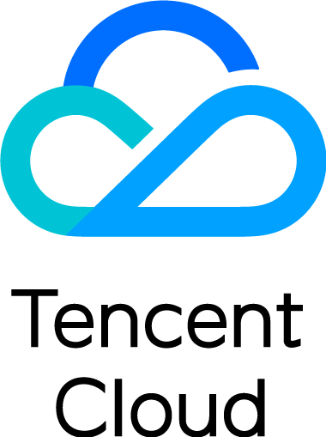

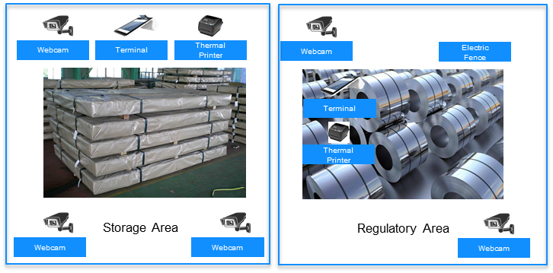

Tencent Cloud: Warehouse Receipt Pledge Financing
The Challenge
Banks focus on risk control for goods and warehouse receipts. SMEs pay attention to pledge costs and financing efficiency. The warehousing needs to improve its service capabilities. The receipts need to be transferred to play the financial instrument attributes.
The Collaboration
Tencent Cloud and its partners use blockchain technology to empower business platforms and implement full pledge process business. Business trust can be established between different entities to achieve multi-party identification and coordination.
The Solution
The supply chain financial system is empowered by Tencent TBaaS platform and Hyperledger Fabric， and integrates smart warehouse, IoT. Through cooperation with various financial institutions, the system provides decentralized, trusted and efficient supply chain financial services.
Results
To reduce the workload of check-in by 50% by sharing documents;
To reduce dispute processing time by providing evidence for damages;
To reduce the inventory check from 10 people one day to 4 people half day;
The inventory data is immediately fed back to stakeholders.

Slide 13
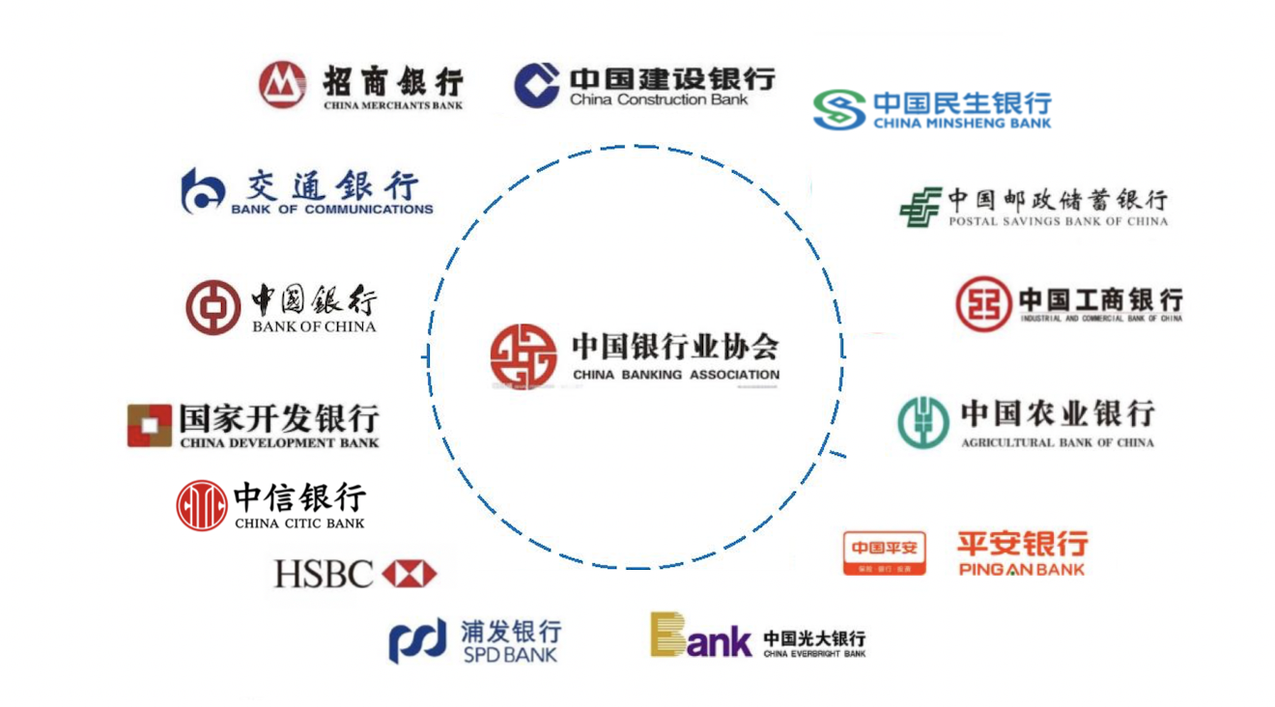

Slide 14

First Blockchain Trade Finance Services Platform in China
Makes Cross-bank Transactions Efficient and Trusted
The Challenge
China‘s trade finance business relies on the SWIFT system for information exchange.
Inter-bank domestic letters of credit and Forfeiting secondary market are still interacting by mail, telephone or email.
The business standards between the lines are not uniform
The Collaboration
China Minsheng Bank, Bank of China and China CITIC Bank setup Trade Finance alliance.
Everbright Bank, Ping An Bank, Hua Xia Bank, Qingdao Bank, Suning Bank, Guilin Bank and more than 20 other banks joined.
The Solution
Based on Hyperledger Fabric as the underlying framework, it has carried out in-depth customized development in line with China's banking regulatory requirements.
The unique Business Point design fully digitizes the letter of credit and Forfeiting business transaction process.
The blockchain network is deployed on cloud servers. Distributed ledger protects the privacy of users and guarantees the high performance of blockchain networks.
Results
This platform is China‘s first blockchain trade finance platform.
Alliance members don’t need to rely on SWIFT message transmission.
Due to the participation of the leading banks, nearly 40 commercial banks have intentionally joined the alliance.
The platform has been in stable operation for 2 years.
The transaction volume is close to 30 billion yuan.

Slide 15
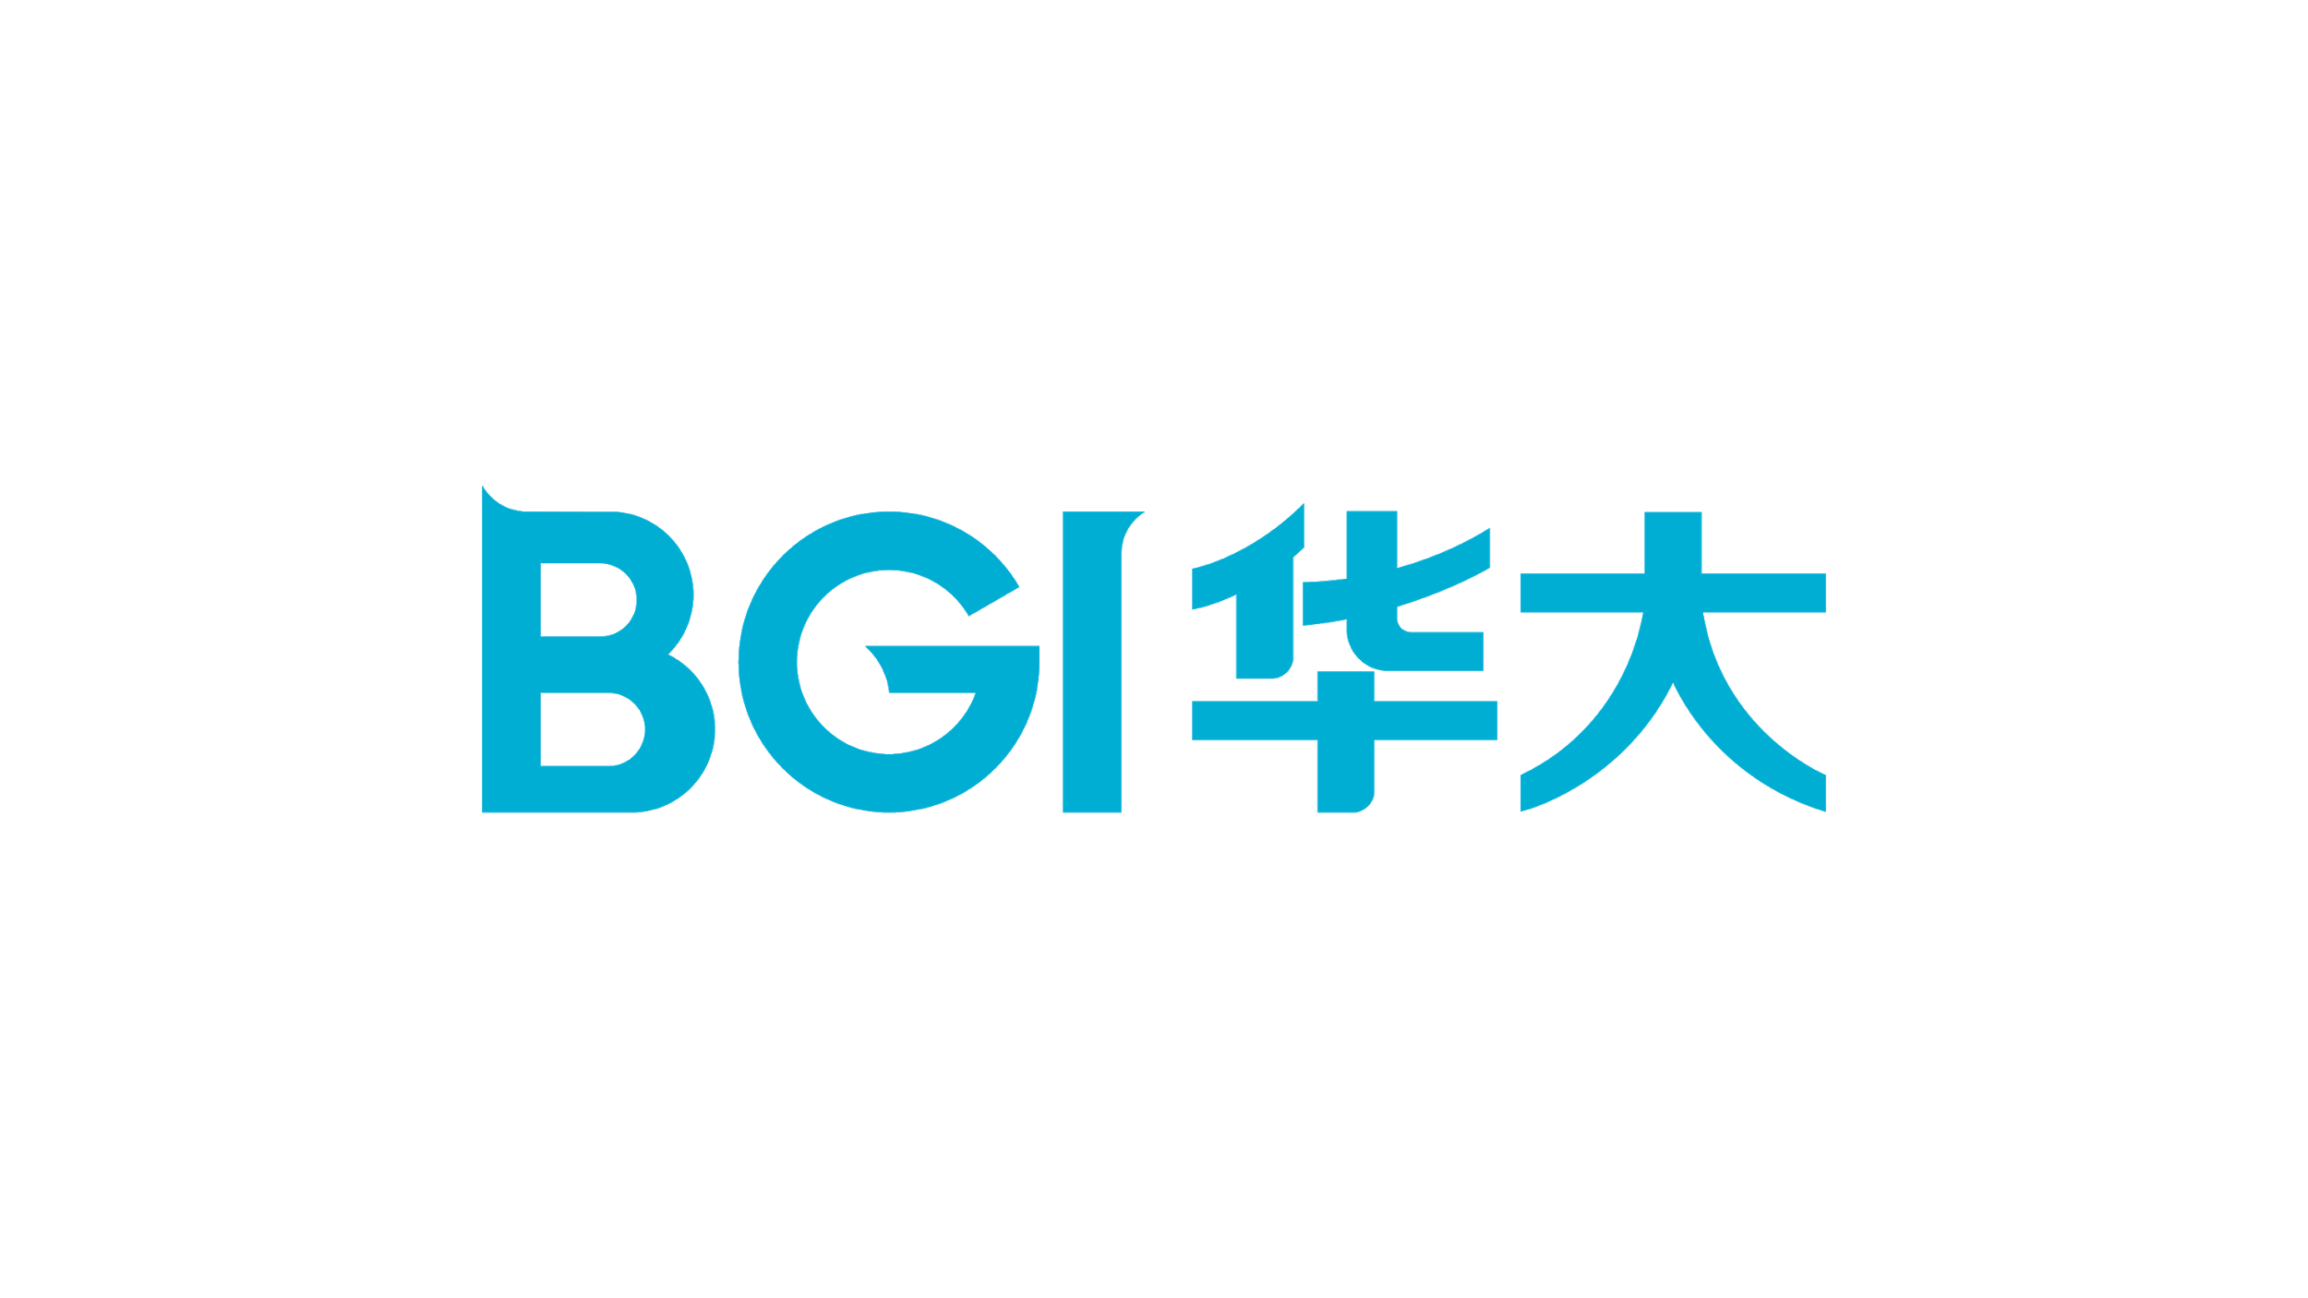
BGI Blockchain - Database of Interpretation Standards for Genetic Variation
The Challenge
The Solution
Results
The collection of large-scale mutation site data faces the following challenges:
1) Sensitivity of genetic data and concerns about privacy protection compliance risks;
2) Organizations use different detection processes and interpretation methods;
3) Gene mutations are significantly different among different populations;
4) The ownership rights of genetic data are not clear,
5) Genetic data is scattered and isolated, and it is difficult to audit
BGI built a database of genetic interpretation standards powered by Hyperledger Fabric, including:
1) Smart contracts to define the data format, content standards, automatic verification, data quality control, and analytical workflow;
2) The summary is on the chain, the digital signature is confirmed;
3) The data is locally parsed, encrypted and desensitized, the global supervision is submitted and traceable;
4) Secure multi-party computing to support authorization access.
This phase has been completed, bringing together 2800+ clinical samples, 700+ unique mutation sites, and 90+ pathogenic or suspected pathogenic sites.
It will be further extended to the establishment of interpretation standards related to the remaining thousands of cancer susceptibility gene mutations.
It will also be extended to address the relationship between competition and cooperation of all kinds of genetic variation databases, and promote the value of multi-party joint mining of gene big data.
Notes:
Challenges
Genes are closely related to human health. Cancer is a disease closely related to genetic variation. The interpretation of the relationship between genetic variation and hereditary cancer disease depends on the accumulation of large-scale mutation site data. The collection of large-scale mutation site data faces the following Challenges:
1) Due to the sensitivity of genetic data and concerns about privacy protection compliance risks, genetic data currently form data silos and cannot share circulation;
2) organizations use different detection processes and interpretation methods, and no uniform standards and norms are formed;
3) The characteristics of gene mutations are significantly different among different populations;
4) the ownership rights of genetic data are not clear, and the circulation of data is restricted;
5) the genetic data is scattered and isolated, and it is difficult to effectively supervise the audit
Technology
A new distributed database sharing architecture based on technologies such as blockchain and cryptography. BGI uses blockchain cryptography and other technologies to help build a database of genetic variation interpretation standards: 1) Smart contract definition data format, and content standards, automatic verification, data quality control; 2) private data main fields and metadata The summary is on the chain, the digital signature is confirmed; 3) the data is locally parsed, encrypted and desensitized, the global supervision is submitted and traceable; 4) the secure multi-party computing supports the private data point-to-point authorization access, and the access record is stored on the chain; 5) Support smart contracts to achieve expert review consensus and continuously improve the accuracy of interpretation of genetic variation;

Slide 16

Thanks!

